Slide 1

Analysis of London Boroughs for Real Estate Investment
IBM Capstone Project: The Battle of Neighbourhoods

Slide 2
Crime Rate and Relevant Nearby Venues
The purpose of the Analysis is to identify which London areas, in this case on a borough-level, are more suitable for a real estate investment targeting potential buyers or renters. In order to do this, two factors have been taken into account : crime rate and relevant nearby venues.

Slide 3
1. Crime Rate
A lower level of crime could be determinant in the decision by a potential tenant/buyer to permanently live in a certain area. Therefore, it might constitute also a determinant for the willingness by those people to pay a higher price to live in a location where they can feel safe.

Slide 4
1. Crime Rate
In this analysis, we retrieve monthly information about London crime from the MPS Borough Level Crime dataset provided by the Metropolitan Police Service for the period between 1/07/2018 and 30/06/2020. The Database is available at this web page:
https://data.london.gov.uk/dataset/recorded_crime_summary

Slide 5
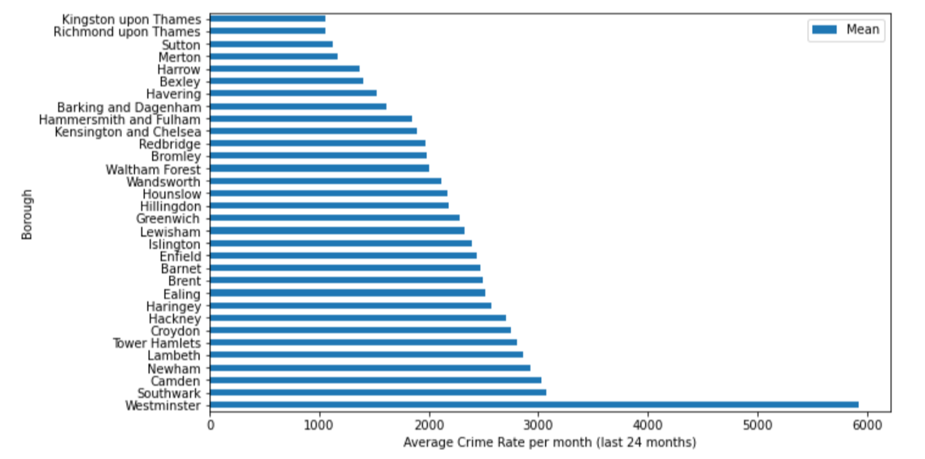
1. Crime Rate: bar chart

Slide 6
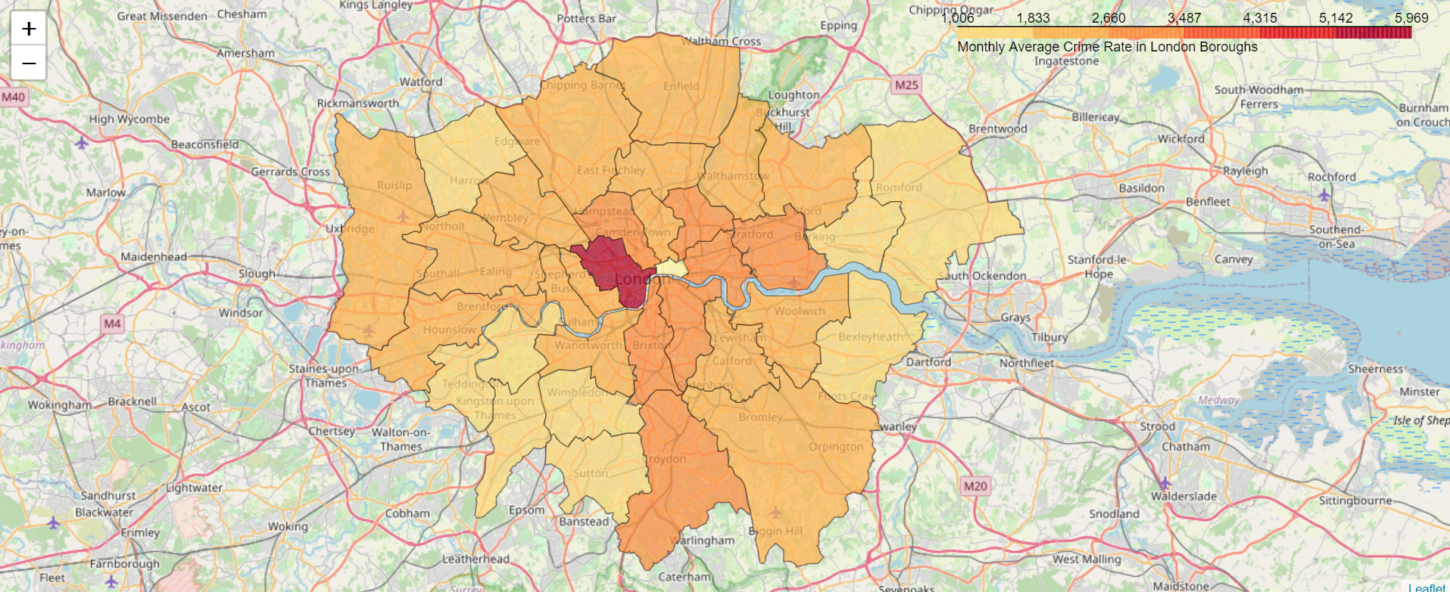
1. Crime Rate: choropleth map

Slide 7
1. Crime Rate
Two aspects easily emerges from the previous bar chart:
Westminster, in the centre of London, is a borough strongly affected by crime, which is understable considering the density of people and services that converge there every day
Kingston Upon Thames, Richmond Upon Thames and Sutton form an ideal top 3 of London Boroughs with very little average crime per month (about 1000 cases per month). Fo this reason, the second section of the analysis will be conducted on these areas.

Slide 8
2. Relevant Nearby Venues
For this analysis we resort to the Fourthsquare API. More specifically, we send an Explore request in order to get venues reccomendation. In every single Top 3 Borough, we search for a couple of relevant venues for each of these four Fourthsquare venues categories:
- Arts and Entertainment
- Food
- Outdoor and Recreation
- Shops and Services

Slide 9
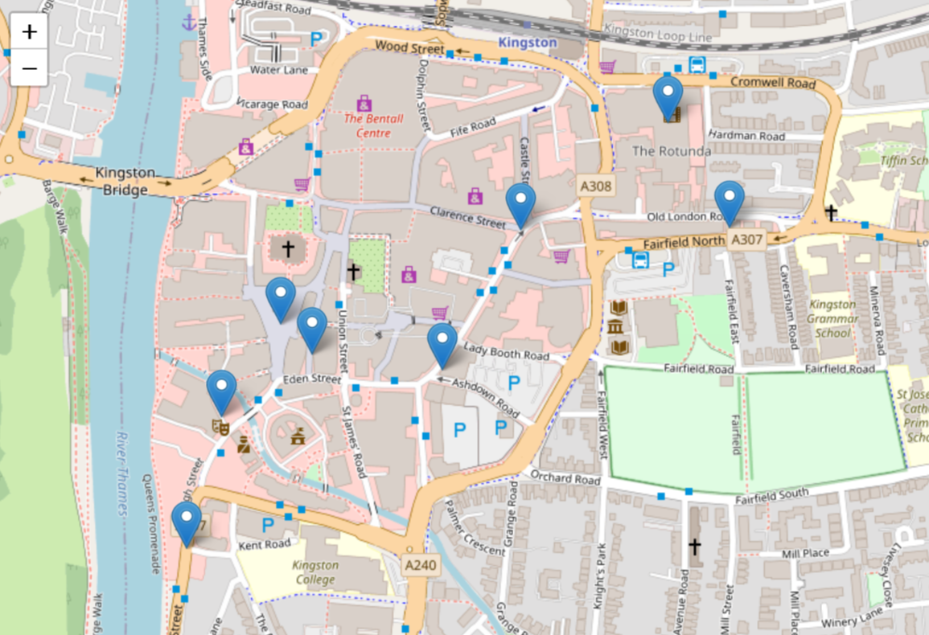
2. Relevant Nearby Venues: Kingston
Kingston Market Place
David Lloyd
Fortunella Cafè
The Fighting Cocks
Rose Theatre
Kingston Town Centre
Stein’s
Banquet Records

Slide 10
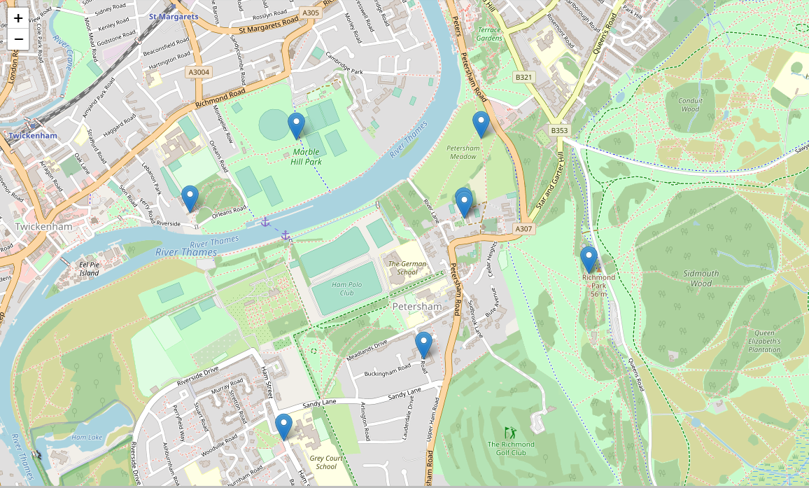
2. Relevant Nearby Venues: Richmond
Marble Hill Park
RSPCA Statue
Petersham Nurseries & Café
Orleans House Gallery
King Henry’s Mound
Hansel and Pretzel
Stephen Charles Landscapes

Slide 11
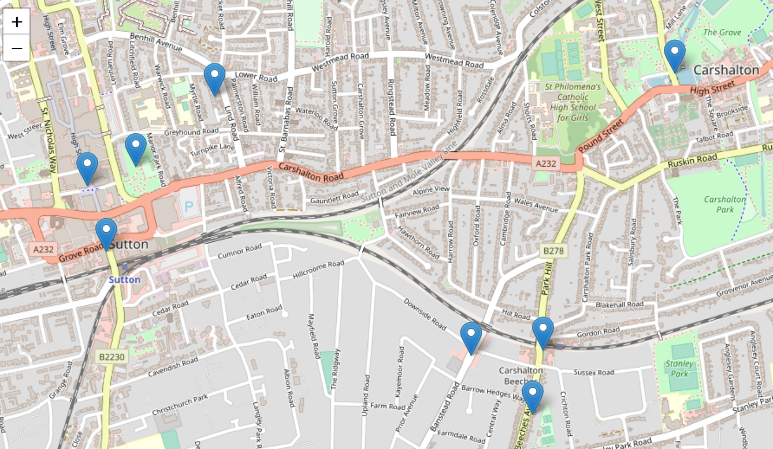
2. Relevant Nearby Venues: Sutton
Soundbox Studios
Carshalton Ponds
Manor Park
Waterstones
Co-op Food
Vinoteca Italiana
Nando’s
Little Holland House

Slide 12
Conclusion
The analysis on a Borough-level has revealed that three London boroughs are safer than the others, and thus, more suitable for real estate investments: Kingston, Richmond and Sutton.
By resorting to the Fourthsquare API, 8 relevant nearby venues, representing 4 different categories, have been identified for each of the top 3 London boroughs; hopefully, they will represent useful parameters for the investor in order to determine which areas of the aforementioned boroughs might be more profitable.

